Slide 1
Time Complexity Analysis
Notes:
‹#›

Slide 2
Purpose
Measure the time taken by programs
Compare two or more solutions to a problem – for their speed
Categorise a program into one of the known categories of time complexities
Notes:
‹#›

Slide 3
(Type of) Problem(s) to be solved
double power(int x, int y) {
long long prod = 1;
int i;
long long term = x;
if(y < 0) {
sign = -1;
y = -y;
}
for(i = 0; i < y; i++)
prod = prod * x;
if(sign == -1)
prod = 1.0 / prod;
return prod;
}
double power(int x, int y) {
long long ans = 1;
long long term = x;
while(y > 0) {
if(y % 2 == 1)
ans *= term;
term = term * term;
y = y/2;
}
return ans;
}
Question: Which solution is better? How much better? How ‘good’ is each solution?
Notes:
‹#›

Slide 4
Measuring the ACTUAL
Time taken by a program
Notes:
‹#›

Slide 5
time ( ) function
The time( ) function gives you the current time in a program
SYNOPSIS
#include <time.h>
time_t time(time_t *t);
DESCRIPTION
time() returns the time as the number of seconds since the Epoch, 1970-01-01 00:00:00 +0000 (UTC).
Notes:
‹#›

Slide 6
time ( ) function
Original code
int main() {
f();
g();
h();
}
Modified code
int main() {
time_t t1, t2, time_taken;
t1 = time();
f();
g();
h();
t2 = time();
time_taken = t2-t1;
}
You can use time( ) function like this in your program to measure time taken by the program
Notes:
‹#›

Slide 7
time ( ) function
Limitations
The original program is modified, so it's no longer the same program
The time obtained includes the time spent in waiting for user input, output and other I/O also
Suppose the user enters the data for a getchar() after 1 hour, then the 1 hour is also included in the time
Notes:
‹#›

Slide 8
gettimeofday() function
The time( ) function returns time in seconds
This may not be useful for programs which run in less time
The gettimeofday() function returns time in microseconds
It can be used in the same fashion as the time( ) function
Notes:
‹#›

Slide 9
The “time” command
You can run any program preceded with the “time” command:
For example, run
time ls
It will show three timings in the end like this:
real 0m0.001s
user 0m0.000s
sys 0m0.000s
Notes:
‹#›

Slide 10
$ time ./a.out
real 0m0.003s user 0m0.001s sys 0m0.002s

Slide 11
The “time” command
The meaning of the three timings shown
Real
This is the total time taken by the program to run, includes the waiting time involves in I/O also
User
The actual CPU time taken by the program
This is the time we are normally interested in
Sys
Time taken by the user program + time taken by the OS
Notes:
‹#›

Slide 12
Use the time command
You should use the time command to run your own programs
Use it like this
time ./program arg1 arg2 arg3
The user timings should be noted down
If the user timing is 0.000s then it means your input size was too low, give a bigger sized input to your program
Notes:
‹#›

Slide 13
Limitations of “measuring actual time”
Needs a running program to begin with
Can't do it with the “idea” of the program, the algorithm
Most of the times we want to discard the idea for a better idea, and write code only for the better idea
Gives the measure of time for a specific input only
Can't tell me in general how the program behaves
This is what we normally want. Know how efficient the program is for any input in general
We can plot a graph of time taken for various inputs to get some idea of the “general” behaviour of “time taken”
Notes:
‹#›

Slide 14
Time Complexity Analysis
Notes:
‹#›

Slide 15
Time complexity Analysis
Normally involves two steps
Deriving an algebraic equation for the time taken by the program
Sometimes we derive three equations: Best case, Average case, Worst Case
Most of the times the Worst case is sufficient
May be difficult for programs which are complicated
Deriving an lower/upper/tight bound on the equation found
Finding a (known) equation, which is better or worse than the equation at hands
Notes:
‹#›

Slide 16
Deriving time taken by a program
Consider this program
int main() {
int x = 10, y = 20, z;
z = x + y;
y = z * x;
return 0;
}
What is the time taken by this program?
How do we measure the time taken by a program algebraically?
Algebraic formula will give the “general” notion about time taken
Notes:
‹#›

Slide 17
Run time not required for ...
Your code is comprised of many “parts”
Some parts of your code are only for the use of compiler
No machine code is generated for them
No memory is allocated for them
They don't consume run-time
Parts of code which “don't run”
#include
#define and all # directives
typedefs
prototype declarations
Type declarations like struct, union
Keywords: if, else, while, for, main, ... etc.
Notes:
‹#›

Slide 18
Run time is required for ...
Time is required, at run-time for only some parts
Parts which actually get converted into machine code and some machine code runs for them when the program is running
Calling a function
int f(int y) { .... }; f(2);
The call f(2); requires time
Allocating local variables and function arguments
f(int x, int y) { int m; }
Allocating memory for x, y, m;
All operations (i.e. use of operators)
+, -, *, / ,...., = , ==, <=, ... , return,
return
Notes:
‹#›

Slide 19
Deriving time taken by a program
Consider this program
int main() {
int x = 10, y = 20, z;
z = x + y;
y = z * x;
return 0;
}
What is the time taken by this program?
How do we measure the time taken by a program algebraically?
Algebraic formula will give the “general” notion about time taken
Notes:
‹#›

Slide 20
Time Taken by a program
Time taken by a program = Sum of time taken by all it’s parts
When we say, constant time: typically some nanoseconds
On faster CPUs e.g. 2GHz vs 1GHz, it may be less
For example a multiplication will typically be faster on a 2GHz processsor than a 1GHz processor
Time taken by various parts
Operations: some constant time
Every operation gets converted into a fixed no. of machine instructions, so it takes some constant time while running
Different operations have different constants. Multiplication and division take a LONG time, while bitwise operations often take a very small time
Function call, return: another constant time
Allocating local variables, arguments: constant time (no matter how many of them)
Notes:
‹#›

Slide 21
Deriving time taken by a program
Consider this program
int main() {
int x = 10, y = 20, z;
z = x + y;
y = z * x;
return 0;
}
Time taken = sum of time taken by various parts
Here all parts take some constant times
4 ‘=’ operations
One + operation
One * operation
One return
One variable allocation
So, total, The program takes some constant time
time_taken( ) = C
Notes:
‹#›

Slide 22
Deriving time taken by a program
Time taken = sum of time taken by various parts
Time taken = Sum of
4 = operations
One function call f()
One return
Variable allocation for main( )
Time taken by f ( ) function
One + operation
One return operation
Variable allocation
All the above times are some constants
So program takes consant time
time_taken( ) = C
Consider this program
int f(int p, int q) {
return p + q;
}
int main() {
int x = 10, y = 20, z;
z = f(x, y)
y = z * x;
return 0;
}
Notes:
‹#›

Slide 23
Deriving time taken by a program
Consider this program
int f(int p, int q) {
return p + q;
}
int main() {
int x, y, z;
scanf(“%d%d”, &x, $y);
z = f(x, y)
y = z * x;
return 0;
}
Time taken = sum of time taken by various parts
Time taken = Sum of
2 ‘=’ operations
One function call f()
One function call scanf()
One return
Variable allocation for main( )
Time taken by f ( ) function
One + operation
One return operation
Variable allocation
Time taken by scanf() function
Assume to be constant
For library functions we NEED TO know their equation for time taken
All the above times are some constants
So program takes consant time
time_taken( ) = C
Notes:
‹#›

Slide 24
Deriving time taken by a program
Consider this program
int f(int p, int q) {
return p + q;
}
int main() {
int x, y, z = 10;
scanf(“%d”, &x);
for(y = 0; y < 10; y++)
z = f(x, y)
y = z * x;
return 0;
}
Time taken = sum of time taken by various parts
Time taken = Sum of
Time taken by scanf() function
Assume to be constant
One ‘*’ operation (z * x)
Two ‘=’ operation (z = 10, y = z * x)
One ‘=’ operation (y =0)
10 ‘=’ operations (z = f(x, y))
11 ‘<’ operations (y < 10)
10 ++ operations (y++)
10 function calls f()
10 * time required for f ()
One return, one ‘+’ operation => Constant
All the above timings and their sum is a constant
So program takes consant time
time_taken( ) = C
Notes:
‹#›

Slide 25
Deriving time taken by a program
Consider this program
int f(int p, int q) {
return p + q;
}
int main() {
int x, y, z = 10;
scanf(“%d”, &x);
for(y = 0; y < x; y++)
z = f(x, y)
y = z * x;
return 0;
}
Time taken = sum of time taken by various parts
Time taken = Sum of
Time taken by scanf() function
Assume to be constant
Constant time operations
One ‘*’ operation (z * x)
Two ‘=’ operation (z = 10, y = z * x)
One ‘=’ operation (y =0)
Variable time operations
x ‘=’ operations (z = f(x, y))
x+1 ‘<’ operations (y < 10)
x ++ operations (y++)
x function calls f()
x * time required for f ()
One return, one ‘+’ operation => Constant
T(X) = X * C1 + C2
Notes:
‹#›

Slide 26
Deriving time taken by a program
Time taken by scanf() function
Assume to be constant
Constant time operations
Z =10, k = 0, y = z* x;
Variable time operations
x Runs of the loop for(i = 0) and k++
Each run of the loop:
One i = 0
Y + 1 times i < y
Y times i++
Y times z =
Y times f(x, y)
Each time of f(x, y) is a constant
X+1 times k < x
T(x, y) = c0 + x * (c4 + y * c2 + y * c1) + c3 + y * c2 + y * c1 + x * c5
T(x, y) = A + Pxy + Qx
Consider this program
int f(int p, int q) {
return p + q;
}
int main() {
int x, y, z = 10, k, i;
scanf(“%d%d”, &x, &y);
for(k = 0; k < x; k++)
for(i = 0; i < y; i++)
z = f(x, y)
y = z * x;
return 0;
}
C0
x * (c4 + y * c2 + y * c1 )
c3
y * c2
y * c1
x* c5
Notes:
‹#›

Slide 27
Deriving time taken by a program
Consider this program
int f(int p, int q) {
return p + q;
}
int main() {
int x, y, z = 10, k, i;
scanf(“%d%d”, &x, &y);
for(k = 0; k < x; k++)
for(i = 0; i < y; i++)
z = f(x, y)
y = z * x;
return 0;
}
Other way of derivation
Time taken by inner loop = Ay + B
Time taken by Outer loop = Time for k=0 + x * (Time taken by inner loop, k < x, k++)
= P + x (Ay + B + C)
= P + Qx + Axy
Time taken by Program = Const + P + Qx + Axy
Notes:
‹#›

Slide 28
Deriving time taken by a program
Solution-1 for the x^y problem
double power(int x, int y) {
long long prod = 1;
int i;
long long term = x;
if(y < 0) {
sign = -1;
y = -y;
}
for(i = 0; i < y; i++)
prod = prod * x;
if(sign == -1)
prod = 1.0 / prod;
return prod;
}
int main() {
int x, y;
scanf("%d%d", &x, &y);
printf("%lf\n", power(x, y));
return 0;
}
If{ } implies that some code may or may not run at times
Such cases lead to 3 different analysis
Best case – minimum possible time
Worst case: Maximum possible time
Average case: Average time, considering all cases
Let’s find the worst case time equation here
In worst case the if() condition is true
Time taken by for loop is Ay + B
So time taken by Power function is
Ay + B + C
Time taken by Main() = Ay + B + C + D
main(y) = Ay + E
Notes:
‹#›

Slide 29
Deriving time taken by a program
Solution-1 for the x^y problem
double power(int x, int y) {
long long ans = 1;
long long term = x;
while(y > 0) {
if(y % 2 == 1)
ans *= term;
term = term * term;
y = y/2;
}
return ans;
}
int main() {
int x, y;
scanf("%d%d", &x, &y);
printf("%lf\n", power(x, y));
return 0;
}
Worst case time equation
power(y) = A * No. Of times the loop runs + B
= A * (log2y + 1) + B
= A * log2y + C
Why log2y?
By definition log2x is number of times division by 2 is required to reduce the number x to 1
Notes:
‹#›

Slide 30
Comparing time taken by two equations
O, Ώ, Ɵ notations
Notes:
‹#›

Slide 31
Consider these two solutions to the power (x^y) problem
term = x *x
prod = 1
for(i = 0; i < y/2; i++)
prod = prod * term;
if(y %2)
Prod = prod * x;
Equation for time taken is
P(y) = A(y/2) + Q
Where
A: constatnt time required for i < y, i++, prod *x, prod =
Q: constant time required for i =0, prod = 1, term = x*x, y%2, prod = prod *x
prod = 1
for (i = 0; i < y; i++)
prod = prod * x
Equation for time taken is
T(y) = Ay + B
Where
A: constatnt time required for i < y, i++, prod *x, prod =
B: constant time required for i =0, prod = 1
Notes:
‹#›

Slide 32
Consider these two solutions to the power (x^y) problem
Here both equations are linear equations
The second equation has a smaller constant A/2 for the y term
The second equation has a bigger constant term Q (Q > B)
Still, we can say that the second one performs better for higher values of y ?
Notes:
‹#›

Slide 33
Comparing two linear solutions
Consider two linear equations
T(y) = 2y + 4
P(y) = 4y + 8
Clearly P(y) = 2 * T(y)
This means solution P is twice as slow as solution T
Suppose we run P and T both on a 2 GHz
Then P will take twice the time to run
Suppose we run P on a 2 GHz machine and T on a 1 GHz machine
Then P and T will take same time to run
This reflects the dependence of the constant 4 in 4y (or 2 in 2y) on the speed of the processor
Equations of the same degree, can be made comparable by changing the processor (i.e. the constants)
Notes:
‹#›

Slide 34
Comparing two functions Not of the same degree
Suppose Equation for time taken is
T(x) = 300x + 500
And another equation for time taken is
R(x) = 3x² + 5x
The constants 300 and 500 are (100 times) higher than the constants 3 and 5 in R(x)
What do we get when we plot the graphs of these two functions?
Notes:
‹#›

Slide 35
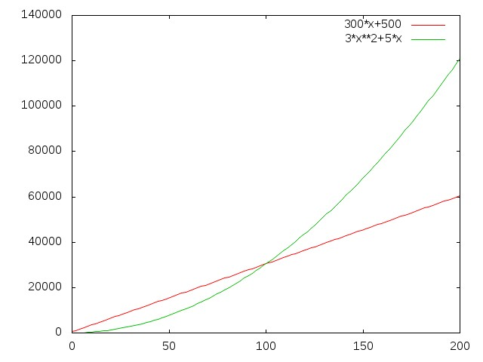
Comparing two functions Not of the same degree
Here we find that even though the constants 300,500 are very high, after x = around 100, the green curve of 3x²+5x is always above the curve of 300x + 500
This is because as value of x grows, the term x² dominates the constant 3 or 300
Notes:
‹#›

Slide 36
Comparing two functions Not of the same degree
Contrast the euqation
T(x) = 300x + 500
With
R(x) = 3x² + 5x
Can we make R(x) run as fast as T(x) if we can get as fast a processor as desired?
Looking at equations, we find that we’ll need a (3x² + 5x) / (300x + 500) times faster processor
This is not possible!
Notes:
‹#›

Slide 37
Comparing two functions Not of the same degree
We find that we can make
T(y) = 2y + 4
P(y) = 4y + 8
Comparable by using a faster processor
But we can’t make
R(x) = 3x² + 5x
comparable with
T(x) = 300x + 500
Using any fast processor
So an equation of a higher degree is qualitatively quite different from an equation of a lower degee
We treat all the equations of a one degree to be comparable to each other
Notes:
‹#›

Slide 38
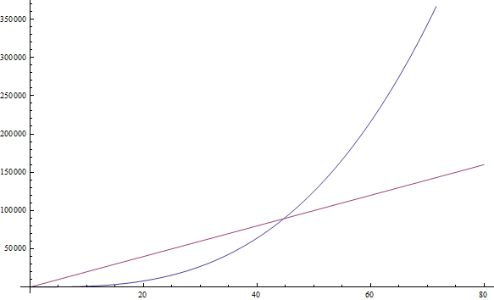
The n³ function, drawn in blue, becomes larger than the 1999n function, drawn in red, after n = 45. After that point it remains larger for ever.
Compare functions: n³ and 1999n
Notes:
‹#›

Slide 39
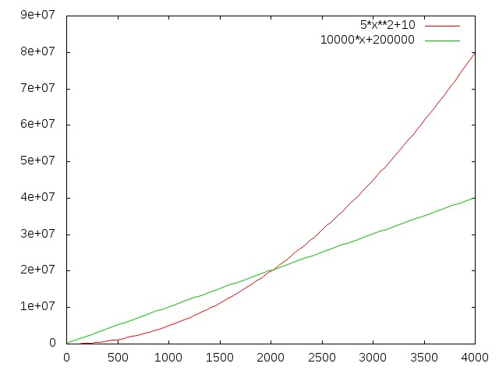
The 5x²+10 function, drawn in red, becomes larger than the 100000x+20000 function, drawn in blue after x = (nearly) 2000. After that point it remains larger for ever. The constants 100000 and 20000, are big but stop making a difference after a x ~=2000
Compare functions: 5x²+10 and 10000x+200000
Notes:
‹#›

Slide 40
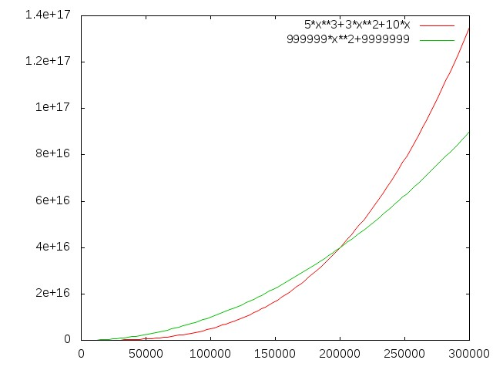
The 5x³+3x²+10x function, drawn in red, becomes larger than the 999999x²+999999 function, drawn in blue after x = (nearly) 210000. After that point it remains larger for ever. The constants 999999 and 999999, are big but stop making a difference after a x ~=210000
Compare functions: 5x³+3x²+10x and 999999x²+999999
Notes:
‹#›

Slide 41
Some key points
Meaning of constant
Actual value of constants depends on
(a) number of steps in the algorithm
(b) speed/quality of the processor
Changing the processor changes constants
E.g. on a 2GHz processor, compared to a 1GHz processor, the constants will be smaller
Notes:
‹#›

Slide 42
3n² + 5x and 300n + 500
n³ and 1999n
5x²+10 and 10000x+200000

Slide 43
General Notes about different degree functions
We saw that a function of a different degree is altogether qualitatively different than a function of a lower degree
All functions of the same degree (differing by constants) are comparable to each other as they only differ by constants
Hence it is imperative to see the behaviour – rate of growth- of different functions
Notes:
‹#›

Slide 44
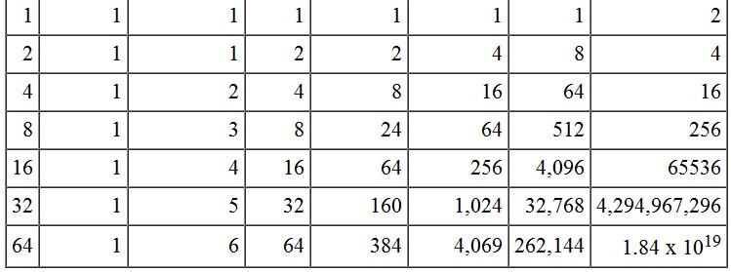
Rates of growth of various functions of n
n 1 log n n n log n n² n³ 2^{n}
https://www.cpp.edu/~ftang/courses/CS240/lectures/img/alg-tab.jpg
Notes:
‹#›

Slide 45
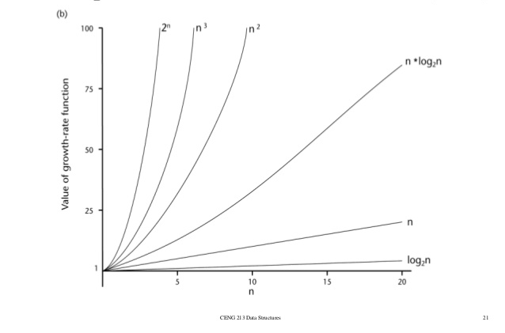
Comparison of rates of growth of various functions
http://www.slideshare.net/sumitbardhan/algorithm-analysis
Notes:
‹#›

Slide 46
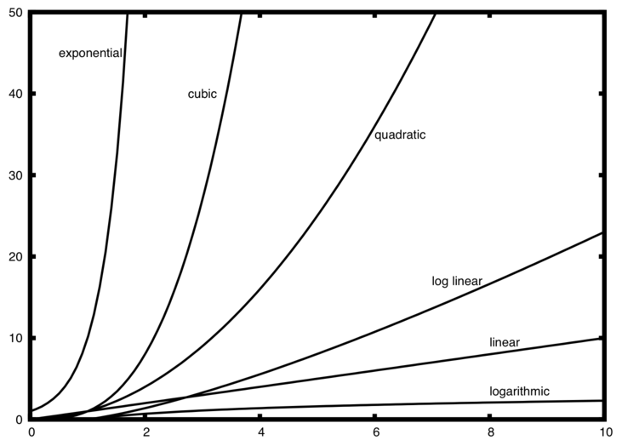

Slide 47
Rates of growth of various functions
The graph on earlier slide shows us that
Some functions like log(n) grow very slowly while some like 2^{n} grow extremely fast
Functions like 2^{n} or even n¹⁰ are horribly expensive
Notes:
‹#›

Slide 48
Comparison of functions
We find that
The constants in equation become less significant as the “size of input” (value of n) grows
The highest degree term in a polynomial equation will dominate other terms as value of n grows
Even if a smaller degree equation has a very high constant, a higher degree equation with a small constant will dominate it after sufficiently high n
Notes:
‹#›

Slide 49
Comparison of functions
We find that
All cn^{p} curves fall in same category and in different category than dn^{q}
If q > p, then all dn^{q} curves will cross all cn^{p} curves sooner or later
Due to this It is generally sufficient to know
That a function behaves “worse” or “better” than (some multiple of) a known function (like n² ore n³ or nlogn, etc )
Notes:
‹#›

Slide 50
Comparison of functions
We find that
The constants in equation become less significant as the “size of input” (value of n) grows
The highest degree term in a polynomial equation will dominate other terms as value of n grows
Even if a smaller degree equation has a very high constant, a higher degree equation with a small constant will dominate it after sufficiently high n
Notes:
‹#›

Slide 51
Comparison of functions
We find that
All cn^{p} curves fall in same category and in different category than dn^{q}
If q > p, then all dn^{q} curves will cross all cn^{p} curves sooner or later
Due to this It is generally sufficient to know
That a function behaves “worse” or “better” than (some multiple of) a known function (like n² ore n³ or nlogn, etc )
Notes:
‹#›

Slide 52
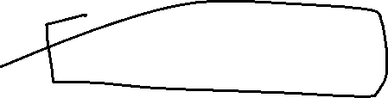

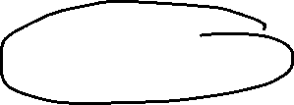



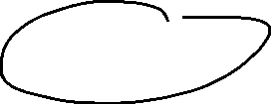



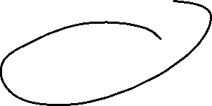

Asymptotic Notations
Asymptotic Notations are mathematical notations used to describe the running time of an algorithm
Following are the commonly used Asymptotic Notations to calculate the running time complexity of an algorithm.
Ο Notation (Big ‘Oh’ )
Ω Notation (Omega)
θ Notation (Theta)

Slide 53

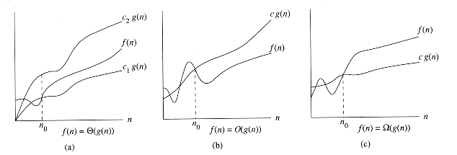
Meaning of O, Ώ and Ɵ notation
f(n) = Ɵ(g(n)) means that f(n) is bound on the upper and lower sides by some multiples of the function g(n)
f(n) = O(g(n)) means that f(n) is bound on the upper side by some multiple of the function g(n)
f(n) = Ώ(g(n)) means that f(n) is bound on the lower side by some multiple of the function g(n)
http://staff.ustc.edu.cn/~csli/graduate/algorithms/book6/chap02.htm
Notes:
‹#›

Slide 54
Big Oh Notation, Ο
The notation Ο(n) is the formal way to express the upper bound of an algorithm's running time. It measures the worst case time complexity or the longest amount of time an algorithm can possibly take to complete.

Slide 55
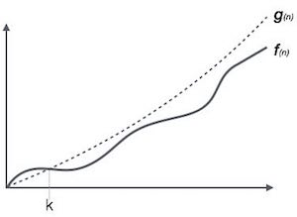
O notation

Slide 56
O notation
For example, for a function f(n)
Ο(f(n)) = { g(n) : there exists c > 0 and n₀ such that f(n) ≤ c.g(n) for all n > n₀ }
Big O of f(n) is bigO of g(n) iif there exist positive constant c and n₀ such that f(n)<cg(n) for all n, n>=n₀

Slide 57
O notation
Find a function, whose constant multiple, is worse than the given function
f(x) = O(g(x)) if and only if there exists a positive real number C and a real number x0 such that
| f ( x ) | ≤ C | g ( x ) | for all x ≥ x 0
Notes:
‹#›

Slide 58
O notation
For example
If f(x) = 2x² + 10
Then
Since f(x) <= 13x² whenever x>=1
f(x) = O(x²)
here c = 13 and x0 = 1, and g(x) = x²

Slide 59
Also, we can say
f(x) <= 3x³, whenever x >=10
So f(x) = O(x³) is also true
Here c = 3, x0 = 10, g(x) = x³
Finding the c, x0 and g(x) can be done by trial/error, intelligent guess, or using algebra

Slide 60
O notation
O notation is called “upper bound”
We always try to find an upper bound which is as low as possible
In the earlier example we have shown that f(x) = O(x²)
Can we show f(x) = O(x)?
Let’s try. Suppose f(x) = O(x)
Then it means f(x) <= cx for some c and when x>=x0
==> 2x² + 1 <= cx
==> 2x² -cx + 1 <= 0
==> x (2x - c) + 1 <=0
==> x <= -1/(2x-c)
Now as x grows, -1/(2x-c) can only get smaller so above condition is impossible
Which means f(x) = O(x) is not possible
So the lowest upper bound we can get is f(x) = x²
Notes:
‹#›

Slide 61
f(n) = 3n + 2
f(n) = O(n)
3n+2 <= 4n
100n + 200 <= 301n => O(n)
10n² + n + 50 <= 61n²
O(n²)

Slide 62
f(n) = 2n+3
g(n) = 3n
O(g(n)) = n
g(n) = n² + n
O(g(n)) = n²
//This is not the tightest / closest upper bound

Slide 63
Omega Notation, Ω
The notation Ω(n) is the formal way to express the lower bound of an algorithm's running time. It measures the best case time complexity or the best amount of time an algorithm can possibly take to complete.

Slide 64
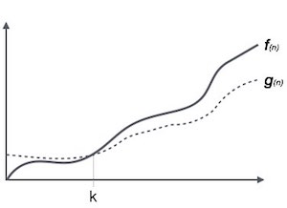

Slide 65
For example, for a function f(n)
Ω(f(n)) ≥ { g(n) : there exists c > 0 and n0 such that g(n) ≤ c.f(n) for all n > n0. }

Slide 66
Ώ notation
Find a function, whose constant multiple, is worse than the given function
f(x) = Ώ (g(x)) if and only if there exists a positive real number C and a real number x0 such that
f ( x ) >= C g ( x ) for all x ≥ x 0
For example
If f(x) = 2x² + 10
Then
Since f(x) >= x² whenever x>=1
f(x) = Ώ(x²)
here c = 1 and x0 = 1, and g(x) = x²
Also, we can say
f(x) >= 3x, whenever x >=0
So f(x) = Ώ(x) is also true
Here c = 3, x0 = 0, g(x) = x
Notes:
‹#›

Slide 67
Ώ notation
Ώ notation is called “lower bound”
We always try to find a lower bound which is as high as possible
In the earlier example we have shown that f(x) = Ώ(x²) and f(x) = Ώ(x) also
Can we show f(x) = Ώ(x³)?
Let’s try. Suppose f(x) = Ώ(x³)
Then it means f(x) >= cx³ for some c and when x>=x0
==> 2x² + 1 >= cx³
==> 0 >= cx^{3 –} 2x²⁻ 1
==> 1 >= x² (cx - 2)
==> 1/(cx-2) >= x²
Now as x grows, 1/(cx-2) can only get smaller so above condition is impossible
Which means f(x) = Ώ(x³) is not possible
So the highest lower bound we can get is f(x) = Ώ(x²⁾
Notes:
‹#›

Slide 68
Big Omega : Ω
f(n) = 3n+2
g(n) = n
f(n) = Ω g(n)
f(n) >= c g(n) { c>=1 and n0 >=1}
3n+2 = Ω(n)

Slide 69
f(n) =3n +2
g(n) = n ²
3n +2 = Ω(n ²) (Is this true?)

Slide 70
3n +2 >= cn ²
(Not possible)

Slide 71
f(n) = n² +n +2 = Omega(n) ??

Slide 72
Theta Notation, θ
The notation θ(n) is the formal way to express both the lower bound and the upper bound of an algorithm's running time. It is represented as follows −

Slide 73
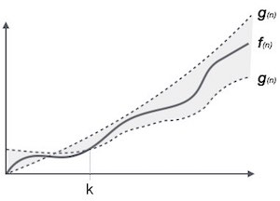

Slide 74
θ(f(n)) = { g(n) if and only if g(n) = Ο(f(n)) and g(n) = Ω(f(n)) for all n > n0. }

Slide 75
f(n) = 3n + 2
g(n) = n
f(n) <= c g(n) { c >3} : f(n) = O(g(n))
f(n) >= c g(n) { c<3 } : f(n) = Ω(g(n))

Slide 76
Ɵ notation
f(n) = Ɵ ( g(n))
If
k 1 ⋅ g ( n ) ≤ f ( n ) ≤ k 2 ⋅ g ( n )
for some positive k1, k2
In short we can say that
if f(x) = O(g(x))
and f(x) = Ώ(g(x))
then f(x) = Ɵ(g(x))
Notes:
‹#›

Slide 77
General rule for polynomials
Try proving this
If
P(x) = a_{n} x^{n} + a_{n-1} x^{n-1} + .... + a₁x + a₀
Then
P(x) = O(x^{n} )
P(x) = Ώ (x^{n} )
And P(x) = Ɵ(x^{n} )
So if
P(x) = 2x⁴+3x²+10
then
P(x) = O(x⁴)
P(x) = Ώ (x⁴)
P(x) = Ɵ(x⁴)
Notes:
‹#›

Slide 78
Time complexity analysis of some algorithms
Notes:
‹#›

Slide 79
Consider the factorial function
The time taken by this code is
T(n) = An + B
As the loop runs n times, and loop body has constant time A
B = constant time required for non-loop code & i=1
Since this is polynomial equation
T(n) = O(n)
T(n) = Ɵ(n) also
This means
The factorial function always runs tightly bound by the linear function
unsigned int fact(unsigned int n) {
int i, sum = 1;
for(i = 1; i <= n ; i++)
sum *= i;
return sum;
}
Notes:
‹#›

Slide 80
Consider the linear search function
int linearsearch(int *a, int n, int x ) {
int h, l;
l = 0;
h = n - 1;
while(l <= h) {
if(a[l] == x)
return l;
if(a[l] > x)
return -1;
l++;
}
return -1;
}
This code does not always run in the same fashion
Depending on the input the code may run some steps and skip some
For example
If x was a[0], then then code will only enter the loop and return
If x was a[3], then the code will run 3 loops
If x was not in the array, then the code may return from the return -1 inside the loop
Etc.
Problem: given a sorted array a, array length n, and a search element x, find the location of x in the array, return -1 otherwise
Notes:
‹#›

Slide 81
Consider the linear search function
int linearsearch(int *a, int n, int x ) {
int h, l;
l = 0;
h = n - 1;
while(l <= h) {
if(a[l] == x)
return l;
if(a[l] > x)
return -1;
l++;
}
return -1;
}
For such code we find three different equations
Worst case
This is the equation for the case when code runs maximum number of steps
Best Case
This is the equation for the case when code runs minimum number of steps
Average case
This is the equation representing average time considering all possible ways in which the code can run
Notes:
‹#›

Slide 82
Consider the linear search function
Worst case
Worst case has to be found by observing the code.
Here, worst case occurs when x > a[n-1]
In worst case, the loop runs n times and finally the last “return -1” is executed
int linearsearch(int *a, int n, int x ) {
int h, l;
l = 0;
h = n - 1;
while(l <= h) {
if(a[l] == x)
return l;
if(a[l] > x)
return -1;
l++;
}
return -1;
}
Notes:
‹#›

Slide 83
Consider the linear search function
Worst case
The time taken in worst case, therefore, is
T_{w}(n) = An + B
Where A = time taken inside loop
B = time taken outside loop
So
T_{w}(n) = Ɵ(n)
int linearsearch(int *a, int n, int x ) {
int h, l;
l = 0;
h = n - 1;
while(l <= h) {
if(a[l] == x)
return l;
if(a[l] > x)
return -1;
l++;
}
return -1;
}
Notes:
‹#›

Slide 84
Consider the linear search function
Best case
Best case has to be found by observing the code.
Here, best case occurs when x is a[0]
In best case, we only run
l = 0;
h = n – 1;
l <=h condition
a[0 ] == x condition and
return 0 ;
int linearsearch(int *a, int n, int x ) {
int h, l;
l = 0;
h = n - 1;
while(l <= h) {
if(a[l] == x)
return l;
if(a[l] > x)
return -1;
l++;
}
return -1;
}
Notes:
‹#›

Slide 85
Consider the linear search function
int linearsearch(int *a, int n, int x ) {
int h, l;
l = 0;
h = n - 1;
while(l <= h) {
if(a[l] == x)
return l;
if(a[l] > x)
return -1;
l++;
}
return -1;
}
Best case
The time taken in best case, therefore, is
T_{b}(n) = C
Where C = Constant
So
T_{b}(n) = Ɵ(1)
Notes:
‹#›

Slide 86
Consider the linear search function
int linearsearch(int *a, int n, int x ) {
int h, l;
l = 0;
h = n - 1;
while(l <= h) {
if(a[l] == x)
return l;
if(a[l] > x)
return -1;
l++;
}
return -1;
}
Average case
Average case analysis is often quite complicated as it involves finding out all possible ways in which the code runs
In how many possible ways the given code runs?
Notes:
‹#›

Slide 87
Consider the linear search function
Average case
If we focus on the fact that the function has to return, then it returns in following possible ways
n ways to return with a[l] == x true
That is x found
n ways to return with
a[l] > x true
That is x not found
1 way to return with -1 in the end (x not found)
Total 2n+ 1 ways to return
int linearsearch(int *a, int n, int x ) {
int h, l;
l = 0;
h = n - 1;
while(l <= h) {
if(a[l] == x)
return l;
if(a[l] > x)
return -1;
l++;
}
return -1;
}
Notes:
‹#›

Slide 88
Consider the linear search function
Average time for linear search = (sum of time required for 2n+1 ways in which code can run) / (2n + 1)
Total time taken in returning with a[l] ==x true:
= (c) + (c + b) + (c + 2b) +... (c+(n-1)b)
Here
c: time required to run l=0; h = n -1; condition l<=h; condition a[l] == x (on success) and return x (on success)
b: time required to run if(a[l] > x) condition; l++; condition l<=h on unsuccessful run of loop
Here c: time required when a[0] == x
c + b: time required when a[1] == x
and so on
Notes:
‹#›

Slide 89
Consider the linear search function
Total time taken in returning with a[l] > x as true:
= (e) + (e + d) + (e + 2d) +... (e+(n-1)d)
Here
e: time required to run l=0; h = n -1; condition l<=h; condition a[l] > x and return -1
d: time required to run (a[l] == x) condition; (a[l] > x) condition; l++; condition l<=h on unsuccessful run of loop
Time taken when x > a[n-1]
= An + B
Notes:
‹#›

Slide 90
Average time for linear search = (sum of time required for 2n+1 ways in which code can run) / (2n + 1)
= ( (c+(c+b)+(c+2b)+...(c+(n-1)b)
+ (e+ (e+d)+(e+2d)...(e+(n-1)d)
+ An + B )
/ (2n+1)
= ( n (c + e + A) + (b + d) (1 + 2 + ... (n-1)) + B )/ (2n + 1)
= (Pn + Q(n-1)n/2 + B ) / (2n + 1)
Here the numerator is a quadratic equation in ‘n’ and denominator is linear equation in ‘n’ so the equation is nearly same as
= Xn + Y + Z/n
Which is a linear equation.
Notes:
‹#›

Slide 91
Consider the linear search function
So average case time for linear search is
T_{a}(n) = Xn + Y + Z/n
= Ɵ(n)
Notes:
‹#›

Slide 92
Consider sine(x) code
double sine(double x) {
int n;
double sum, term;
n = 3;
sum = x;
term = x;
while(isgreater(fabs(term), 0.0000000001)) {
term = (term * x * x) / ( n * (n -1));
if(n % 4 == 3)
sum -= term;
else
sum += term;
n = n + 2;
}
return sum;
}
Here although we have an if-else code, both the if and else parts take same time
So we don’t have a worst/average/best case scenario here
We only need to find one equation
Notes:
‹#›

Slide 93
Consider sine(x) code
double sine(double x) {
int n;
double sum, term;
n = 3;
sum = x;
term = x;
while(isgreater(fabs(term), 0.0000000001)) {
term = (term * x * x) / ( n * (n -1));
if(n % 4 == 3)
sum -= term;
else
sum += term;
n = n + 2;
}
return sum;
}
Here the crucial question is how many times does the loop run?
This is not so easy to answer and will involve analysing the Taylor’s series and the loop conditions
Take this as a homework
Notes:
‹#›

Slide 94
Homework: Binary search
int binarysearch(int *a, int n, int x ) {
int l, h, m;
l = 0;
h = n - 1;
while(l <= h) {
m = (l + h) / 2;
if(a[m] == x)
return m;
else if(a[m] < x)
l = m + 1;
else
h = m - 1;
}
return -1;
}
Do the worst, best, average case analysis of binary search.
Notes:
‹#›

